Slide 1
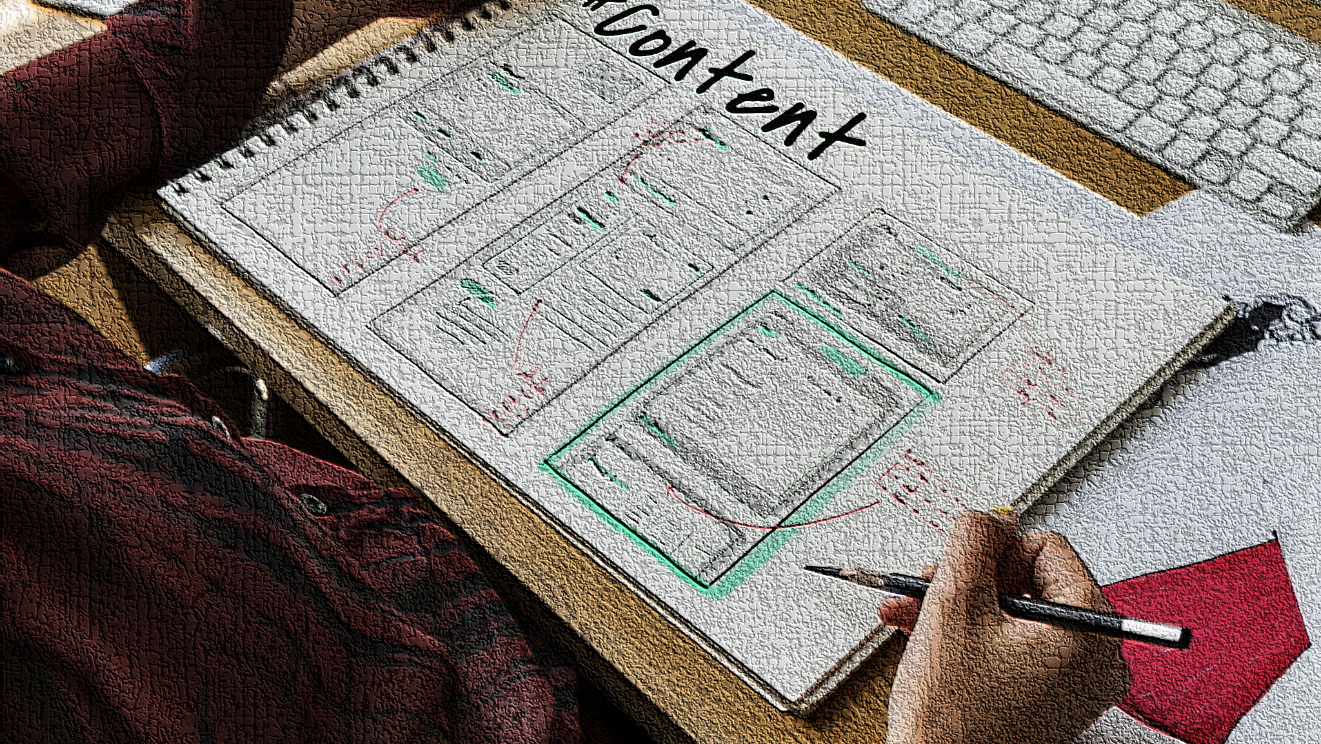
STORYBOARD
AMAP Shopping Centre
Notes:
This is a storyboard for AMAP shopping centre.

Slide 2
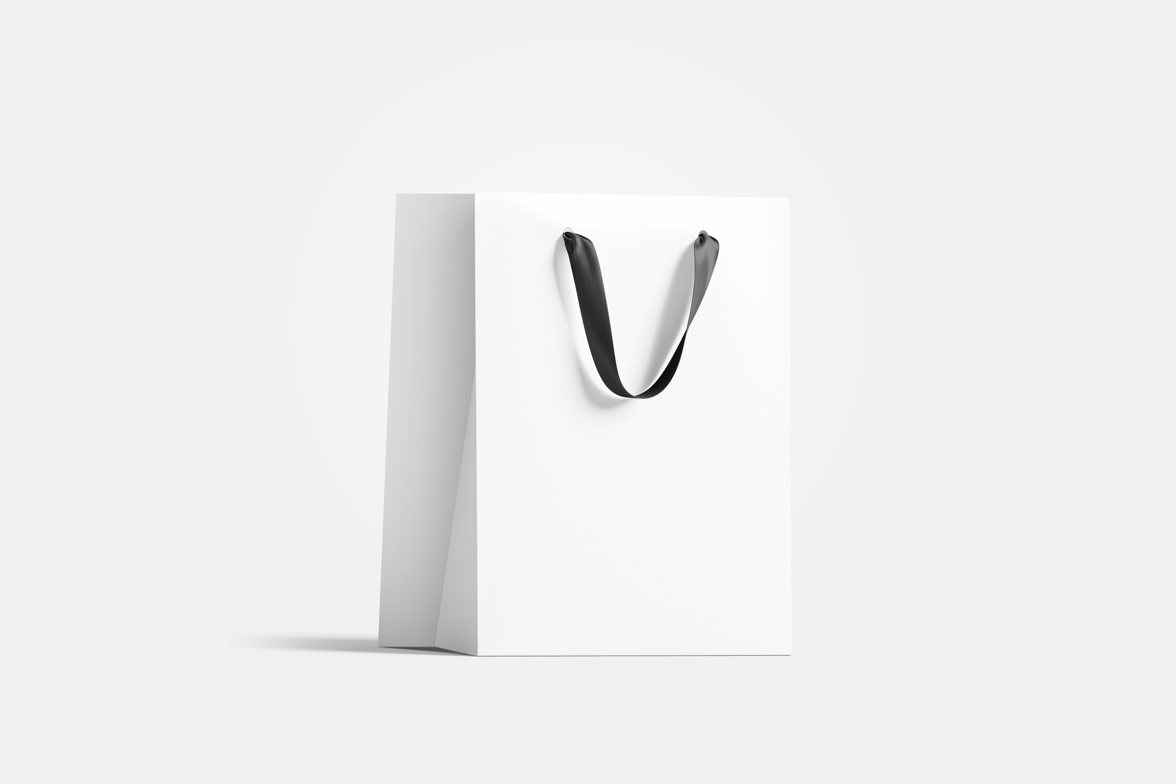
MENUS
Parking
Banks
Shopping
Food
Sport
Leisure
Blueprint of shopping centre
Special offers
Disabled access facilities
Centre information - fire escapes
Help on how to navigate the interface
Notes:
The AMAP Shopping Centre application will have the above-listed menus as preferred by the clients.

Slide 3
#homepage
No header section.
Only footer
AMAP Shopping Centre
Helvetica Bold (60px), highlighted, “Arc in” animation
Food
Shop
Leisure
Offers
Parking
Banks
Help
Services
Accessibility
Open hours
Menus with button effect; orange padding and green hover effect. Font; 22px Helvetica and bubbles-like animation
MAP
Enlarged map of the shopping centre.
footer that covers the entire width of the interface with contact information and social media links.
Notes:
This storyboard was created after the review from the clients. The main page has eleven menus which is six more than the previous ones. We increased the options because we missed to include accessibility facilities of the shopping centre. We also added opening times of the place separately.
From the top, the main page will not have header section but will have footer section. Instead of header, there will be huge “Welcome to AMAP shopping centre” texts, highlighted and bold. The text will have “Arc in” animation effect to make the page attractive and interactive.
The menus will also have animation but a different. The “bounce in” effect will make the menus bounce like football once it appears. Such animation will bring joy to kids and make the machine appear friendly.
The next section in the same page will be the enlarged map of the shopping centre. To access this blueprint, users can either scroll down or simply press “map” from the menu.
Lastly at the bottom will be the footer which is similar to our initial draft. It has dark background with white font. In addition to contact information and social media links, it will also contain brief introduction about the AMAP shopping centre inviting customers to visit the place.

Slide 4
#sub-categories
AMAP Shopping Centre
Clickable header present unlike in homepage; will redirect to homepage
Go back button
Increase navigation
Fashion
Tech
Stationery
Grey whitespace
Sports
Jewellery
footer that covers the entire width of the interface with contact information and social media links.
Notes:
This is the layout for the sub-menus which is displayed if or when users selects the “shop” category. Instead of displaying all the stores found in the shopping centre, they are carefully categorised into different sectors. Users can make further selection and access the store lists that only relevant to their interest.
The whitespace will be grey in colour which hex code is mentioned in the mood board. Unlike the homepage, this page will have header section. The header will contain the name of the place but will be clickable that will take users to homepage in case they wish to start from the beginning.
There is also “go back” button. The button has white background, orange text, and the orange border lines to resemble the consistent colour scheme. This page will also have GIFs in loop in each categories, for example, a video of close-up look of ring is placed in jewellery.
The footer will be the same as the homepage and will continue to be the same throughout the rest of the pages.

Slide 5
Grey background with black texts
#store list
AMAP Shopping Centre
Go back button
Clickable header present unlike in homepage; will redirect to homepage
different font sizes: name (20px), description (18px), location(16px)
Logos or pictures of stores
Descriptions: name of store, floor, exact location. E.g. next to Nike.
store1
Descriptions: name of store, floor, exact location. E.g. on the left of Vue.
store2
store3
Descriptions: name of store, floor, exact location. E.g. in front of Nike.
Vertically sorted list
footer that covers the entire width of the interface with contact information and social media links.
Notes:
Instead of dual columns, I changed the store list to single column as per the feedback of the Director. The traditional layout will recall familiarity in users. On the creator’s side, it will give me different sorting and filtering options.
The page will have all the store’s respective logo on the left-hand side. On the right-hand side are their descriptions and where they can be found. The three common elements on this page are the “go back” button, header and footer.
As labelled, the texts on this page will be large. This will increase readability to the users who have visual impairments.

Slide 6
#offers
AMAP Shopping Centre
Go back button
Grey whitespace
Bright red and captivating banner
Pictures of sales, offers, discounts, and brands
Font size 15px
Pictures of sales, offers, discounts, and brands
Pictures of sales, offers, discounts, and brands
Type of offer
Green bg, white font
Type of offer
Type of offer
footer that covers the entire width of the interface with contact information and social media links.
Notes:
On the “offers” page, I changed the layout from vertical to horizontal, because the offers are not necessarily stores. They are just to show what type of promotions are being done by the stores. It could be student discount, sales, offers, festival discounts, or black Friday sales. So, it is only right that I design these page slightly different from the store list.
The page will have a huge banner that contains video that says “SALE” in all capital letter. The banner is red in colour to seize the customer’s attention. Below the banner will be the lists arranged horizontally. It will contain the site that is doing the promotion with the specific type of discounts or sales specified under the image. The text box is filled with green colour and the font is white.

Slide 7
#parking
AMAP Shopping Centre
Bold and underlined link to open hours for better navigation.
Go back button
Short description of parking features
Photo of parking areas
Short description of parking features
Photo of parking areas
More parking features; location of spaces; highlighted in bold.
Parking rates
Bold and underlined link to open hours for better navigation.
footer that covers the entire width of the interface with contact information and social media links.
Notes:
The parking page of the digital sign solution has three sections excluding header and footer. The first section is comparable to my initial storyboard i.e, the zig-zag layout for different types of parking services.
On top, the photo is places on the right side with description on the left side and vice-versa for the next one right below it. This unconventional format is designed to bring uniqueness to the digital sign.
The second section will be a list of additional services that is offered by the AMAP shopping centre. The list will not be standalone but rather attached with its location on the same sentence. The location will also be highlighted in bold to emphasize the visibility of the information.
Lastly, the final section will have the parking rates arranged in tables. To increase the accessibility of this page, we added two links at the top and the bottom. Just below the header is a text that will redirect users to opening hours of the place and the other link is placed just above the footer.
The links are also highlighted in bold and underlined. I added instruction like “click here” to hint users that it texts are links.

Slide 8
#Help
AMAP Shopping Centre
Header
Go back button
How to navigate digital sign
Detailed video guide
showing how to use digital sign
Grey whitespace
Tutorial video
Email and phone number
Grey whitespace
Contact information for lost items.
Footer
footer that covers the entire width of the interface with contact information and social media links.
Notes:
The help page will include a tutorial video that inform users how to navigate the digital sign. As labelled, this interface will have title for the video such as “How to use digital sign?”.
This page has very few contents. Thus, it leaves a lot of whitespace. This is precisely why I used grey background. Had I chosen the clear white background, it will be too bright for our eyes and thus one will have to squint to read or watch the video. This causes discomfort in customers’ eyes and makes the machine less user-friendly.
At the bottom of the video, I have added another informative content. Users can contact the number or email in case they lost their personal items or sensitive documents.

Slide 9
#services
AMAP Shopping Centre
TITLE with black font, 30px
Grey whitespace
Go back button
links to accessible toilets and services; highlighted in bold and underlined
Section 1
List of services available, pictures and icons
Section 2
Toilets; how to find them; pictures of signs; links to accessible toilets and services
Section 3
Exits; how to find them; pictures of signs
footer that covers the entire width of the interface with contact information and social media links
Notes:
Identical to “parking” page, this page is also divided into three parts. Section one contains the services that are available in the shopping centre like free Wi-Fi, post offices, and in-post lockers.
Section two contains information about where and how to locate toilets. To make the information easy to memorize, images are used rather than long description. The images of icon are exact replica of what can be found in the shopping centre. Customers are less likely to be confused and more likely to find the toilets, lifts or exits quickly.

Slide 10
Clickable header present unlike in homepage; will redirect to homepage
#accessibility features
AMAP Shopping Centre
Go back button
Grey background with black texts
Visual impairment support; picture of description; location where the support is accessed
Icon for disabled toilets; picture
Icons for accessible lifts; picture
Braille on lifts; picture
footer that covers the entire width of the interface with contact information and social media links
Notes:
This slide is similar in structure compared to “offers” page. The title “Accessible” is situated just below the header. It is bold and written with black font.
Underneath the title, the information on different types of support AMAP provides is attached.
The director preferred the accessibility feature to be considered as one of the main menus. The emphasis he wants to give on this feature implies that he wants to help people with physical challenges have fun while shopping at AMAP. That is why I included as less texts as possible to make sure that all customers understand the knowledge available here.
The three pictures from left to right are: signs for disabled toilets; accessible lifts; picture of braille on lifts. These pictures are large in size and there is sufficient gaps between one another.

Slide 11
#Open hours
AMAP Shopping Centre
Go back button
Link to parking services; underlined and bold
Grey background ; black font
Shopping centre opening and closing timetables
Picture of timetable
footer that covers the entire width of the interface with contact information and social media links
Notes:
This page simply contains two elements.
Link to parking services, formatted in bold and underlined.
Opening and closing times for shopping centre throughout the week.
The font in all pages are Helvetica. No other fonts were used for the sake of clarity and readability. Some texts are formatted but the rest are simple present in different sizes. Titles in every pages are of the same font sizes as well. Other common features are the presence of grey white spaces on all pages, same footer and header section and “go back” button except in the homepage.

